Slide 1
Chat Assistant iBot
Capstone Project

Slide 2
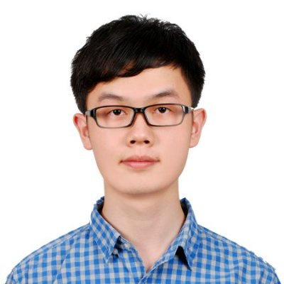
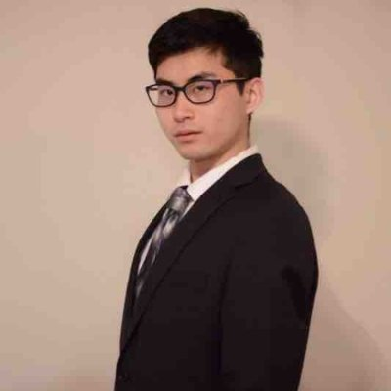
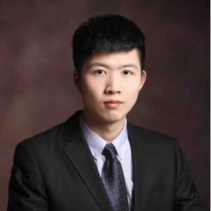

Who are we?
Xiao Liang
Xuzhou Yin
Young Liu
Yun Ma
Instructor: Perumal N. Ramasamy (ramasamy.12@osu.edu)
Point of contact: Branden Bellanca (bbellanca@netjets.com)
Notes:
Young

Slide 3

What is the problem?
In NetJets, some tasks that IT staff is doing every day have cumbersome steps and unnecessary complexity. Time is money, simplifying the workflow is urgent.
Notes:
Young

Slide 4
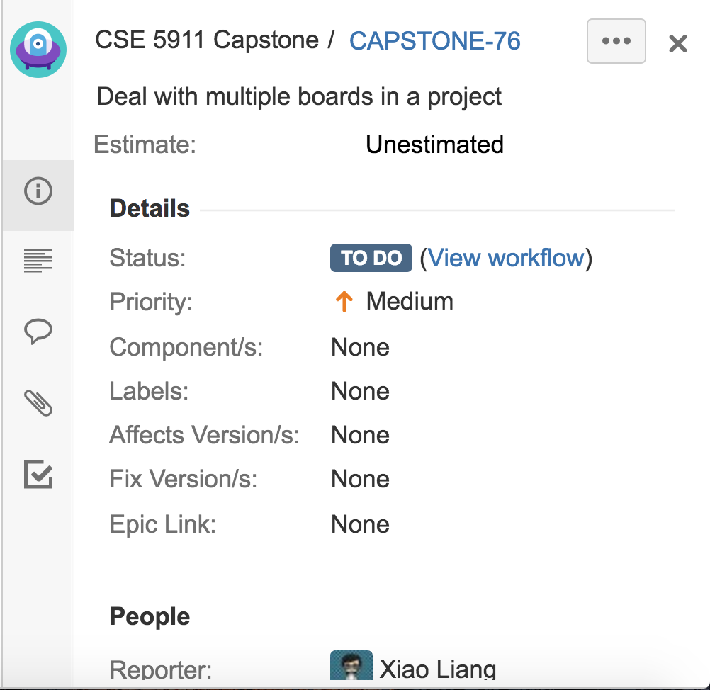
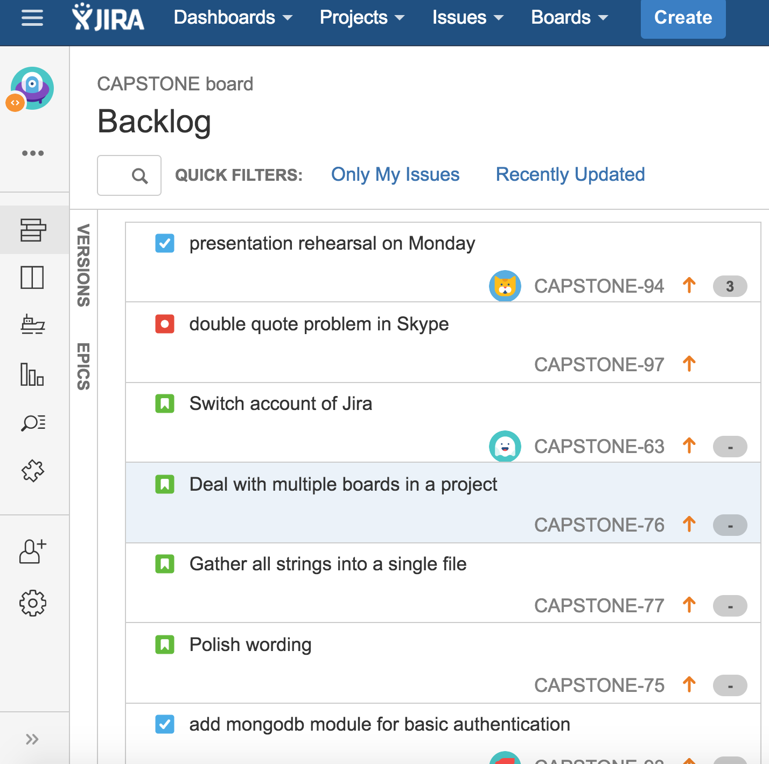
Project Management - Jira
Jira issue
Jira backlog
Notes:
Young

Slide 5
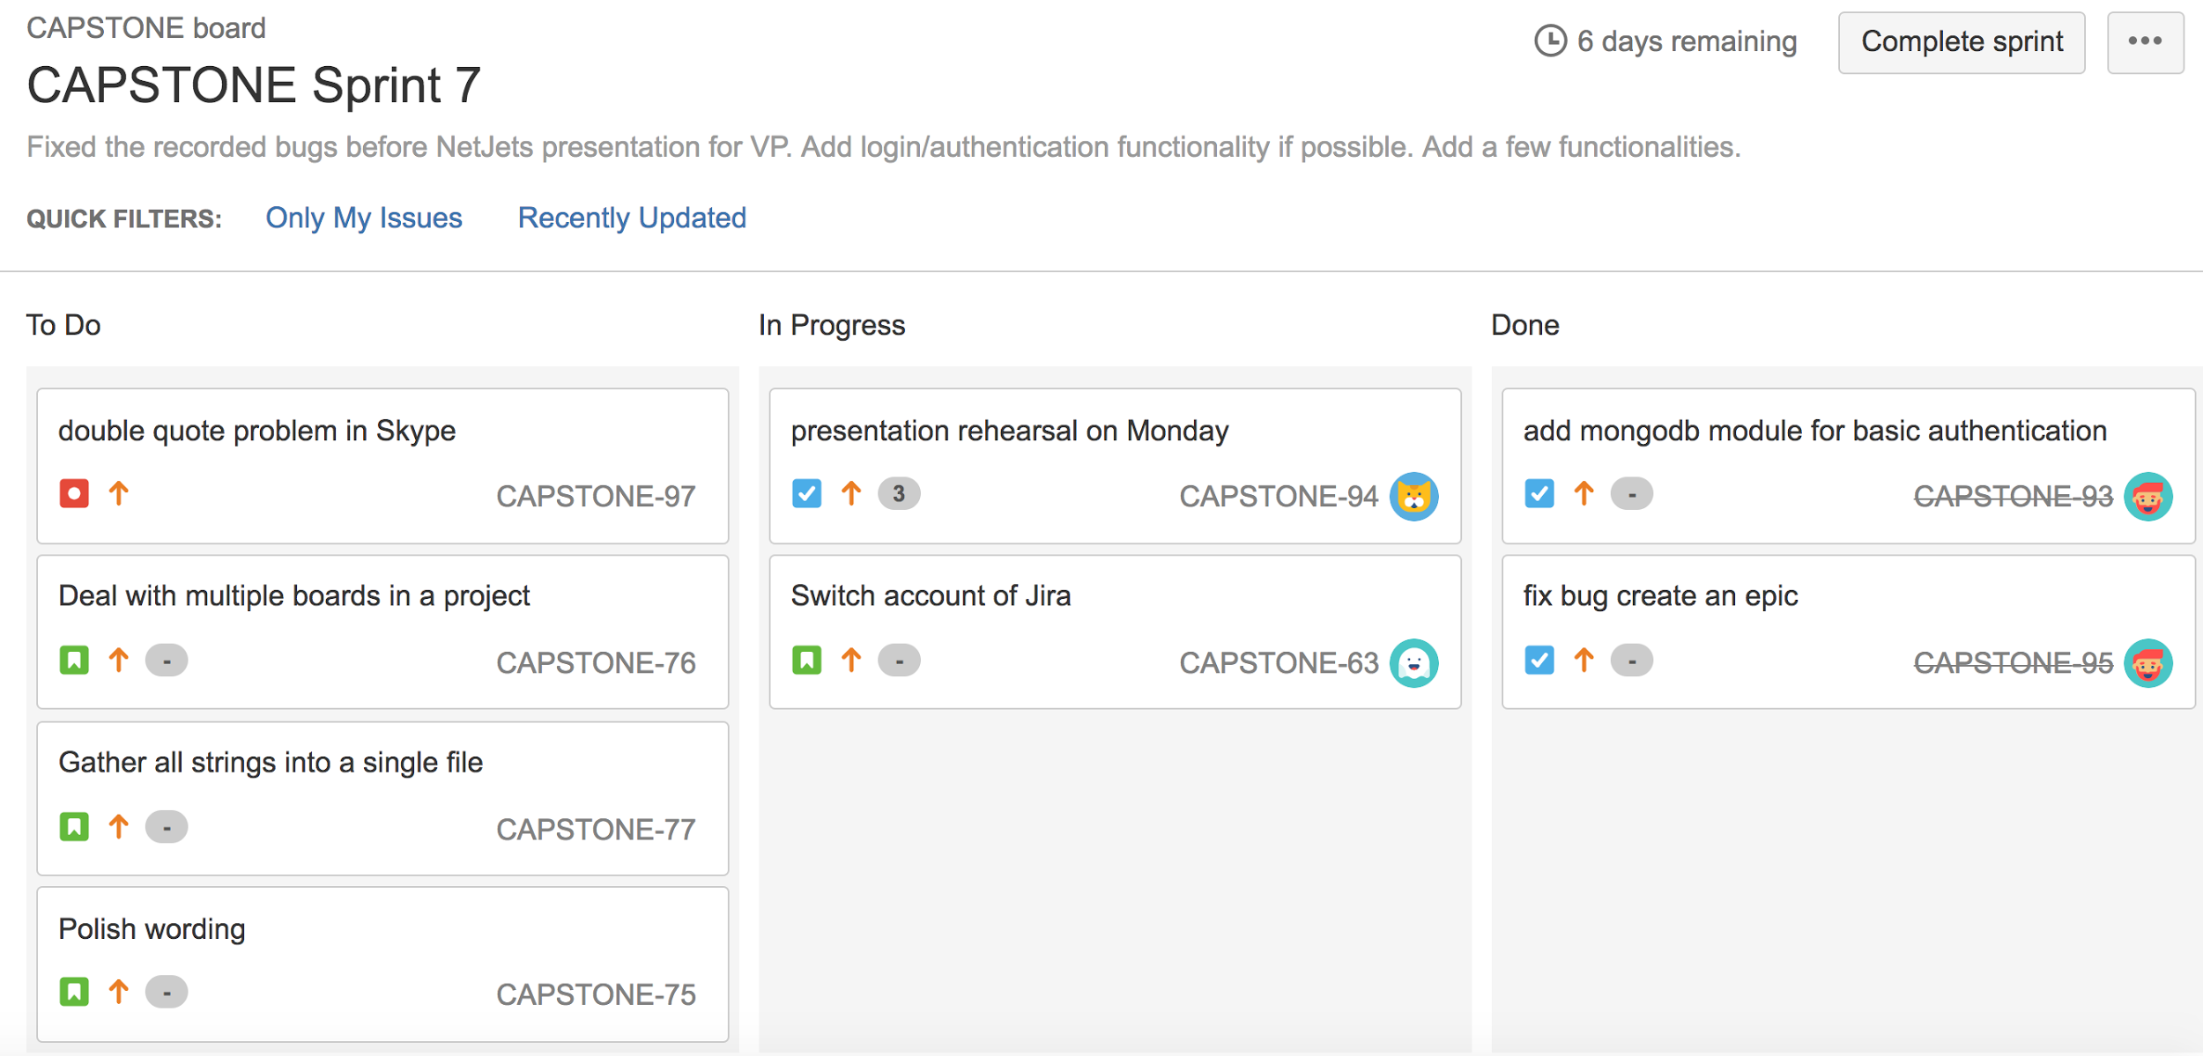
Project Management - Jira (cont.)
Jira sprint
Notes:
Young

Slide 6

Solution
Hide irrelevant details
Make it intuitive
Do it with conversation
Notes:
Young

Slide 7
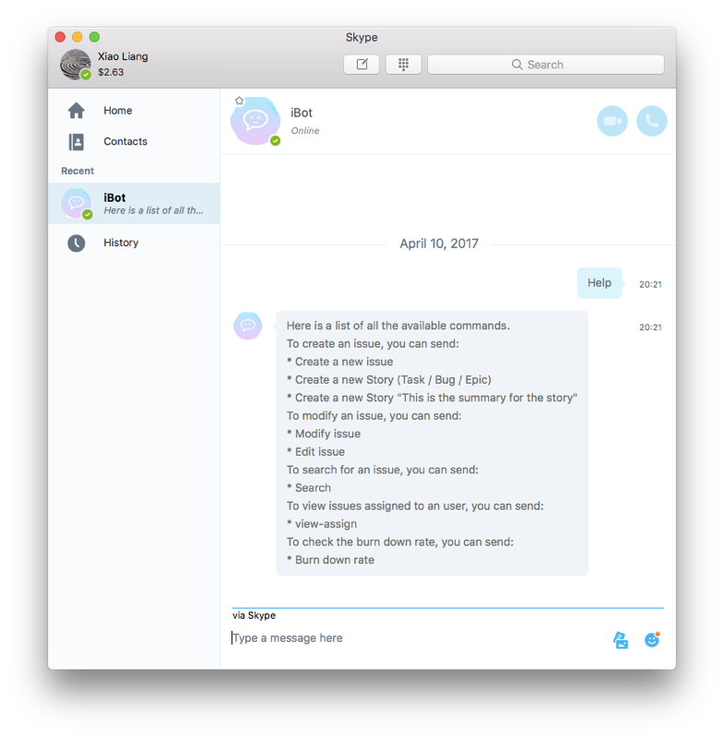
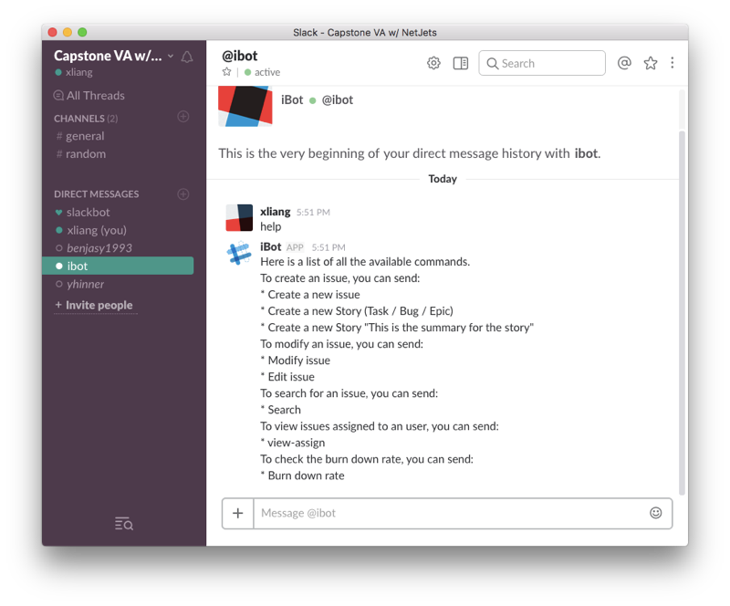
iBot on Skype
iBot on Slack
Notes:
Young

Slide 8
What is iBot?
A responsive user-oriented chatting robot
Accurately understands human language
Interacts with project management platform
Proudly supports multiple mainstream communication channels
Skype, Slack, Emulator, Facebook Messenger…
Identifies users and provides customized services
Notes:
Young

Slide 9

Technology
BOT Framework
Node.js
LUIS
MongoDB
Notes:
Xiao

Slide 10
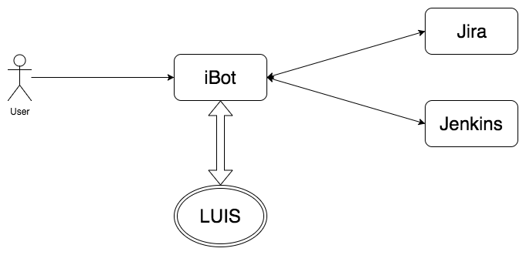
Under the hood...
iBot - Jira/Jenkins
User - iBot
iBot - LUIS
RESTful API calls
Input human language and output result
Analyze words into intent and entity with machine learning
Notes:
Xiao

Slide 11
Whole bunch of abilities...
Respond when user joins
iBot sends a greeting when user joins
Create cards/issues in Jira
Add summary
Move to current Sprint
Search cards/issues in Jira
Return matched info cards
Assign issues to user
Select one in members list
Change issue status
Choose any pre-defined status in Jira
Set priority to each task
Cancel issue creation
Choice to cancel an issue creation process
Help command
List of possible features
Log in / Log out
switch between users
Other features
Burn down rate
Cancel at any time
Notes:
Yun

Slide 12
DEMO

Slide 13
Log in
Linking accounts (first-time sign in)
Sign in
Username, password, Jira URL
Sign out
Only need to enter password signing in next time
Switch account
Need to enter username, password and Jira URL next time when sign in
Notes:
Xuzhou

Slide 14
Create Issue
Choose type
Create Story / Task / Bug / Epic / Sub-task
Create issue with double quotes
Add to current Sprint
Yes / No
Create
Notes:
Yun

Slide 15
Modify after Create
Add comment
Add description
Change status
Assign to user
Set priority
Direct Modify
Search for issue first
Modify
Notes:
Xiao

Slide 16
Search by keyword
Return a list of cards
Search failure
Search by user
See issues assigned to user
Search
Notes:
Yun

Slide 17
Ask for burndown-rate
Valid burn-down-rate
Burn-down-rate failure
Others
Notes:
Young
Burn down rate measure how much percent we have completed for our project. The calculation is weighted by a card’s relative importance. We need to specify this importance field at first which is called measure in Jira. Now I ask to

Slide 18
More features to expect...
Support more commands
Group chat with multiple users
Integrating with more DevOps tools
Voice input
View calendar, generate weekly summary, user-defined operations...
iBot takes notes in group chat meeting
• |  | • |  |  | • |  |  |  | •
BitBucket, Jenkins, Salesforce...
Voice recognition
Notes:
Xuzhou

Slide 19

Questions?
Thanks

